Slide 1
My journal to python ver.2
11/30
NAME: 艾綺絲
STUDENT ID: 4110E224

Slide 2

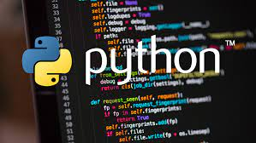

agenda
PYTHON LIST
PYTHON TUPLES
PYTHON SETS

Slide 3
Python Lists
List
Lists are used to store multiple items in a single variable.
Lists are one of 4 built-in data types in Python used to store collections of data, the other 3 are Tuple, Set, and Dictionary, all with different qualities and usage.
mylist = ["strawberry", "grapes", "orange"]

Slide 4


Lists are created using square brackets:
Example

Slide 5
List Items
List items are ordered, changeable, and allow duplicate values.
List items are indexed, the first item has index [0], the second item has index [1] etc.

Slide 6
Ordered
When we say that lists are ordered, it means that the items have a defined order, and that order will not change.
If you add new items to a list, the new items will be placed at the end of the list.
Note: There are some list methods that will change the order, but in general: the order of the items will not change.

Slide 7
Changeable
The list is changeable, meaning that we can change, add, and remove items in a list after it has been created.

Slide 8


Allow Duplicates
Since lists are indexed, lists can have items with the same value:
Example

Slide 9


List Length
To determine how many items a list has, use the len() function:
Example
Print the number of items in the list:

Slide 10

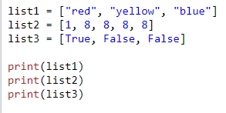
List Items - Data Types
List items can be of any data type:
Example
String, int and boolean data types:

Slide 11


A list can contain different data types:
Example
A list with strings, integers and boolean values:

Slide 12


type()
From Python's perspective, lists are defined as objects with the data type 'list':
<class 'list'>
Example
What is the data type of a list?

Slide 13


The list() Constructor
It is also possible to use the list() constructor when creating a new list.
Example
Using the list() constructor to make a List:

Slide 14
Python Collections (Arrays)
There are four collection data types in the Python programming language:
List is a collection which is ordered and changeable. Allows duplicate members.
Tuple is a collection which is ordered and unchangeable. Allows duplicate members.
Set is a collection which is unordered, unchangeable*, and unindexed. No duplicate members.
Dictionary is a collection which is ordered** and changeable. No duplicate members.

Slide 15


Python - Access List Items
Access Items
List items are indexed and you can access them by referring to the index number:
Example
Print the second item of the list:
Note: The first item has index 0.

Slide 16


Negative Indexing
Negative indexing means start from the end
-1 refers to the last item, -2 refers to the second last item etc.
Example
Print the last item of the list:

Slide 17

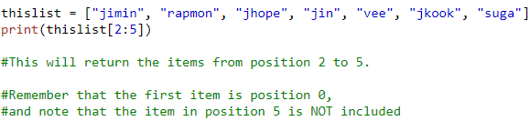
Range of Indexes
You can specify a range of indexes by specifying where to start and where to end the range.
When specifying a range, the return value will be a new list with the specified items.
Example
Return the third, fourth, and fifth item:
Note: The search will start at index 2 (included) and end at index 5 (not included).

Slide 18
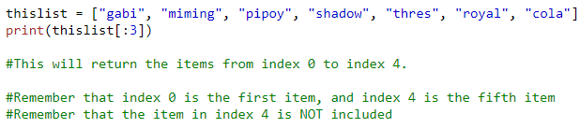

Remember that the first item has index 0.
By leaving out the start value, the range will start at the first item:
Example
This example returns the items from the beginning to, but NOT including, “pipoy":

Slide 19
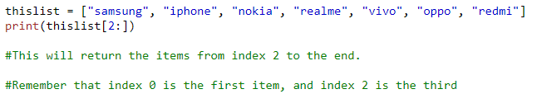

By leaving out the end value, the range will go on to the end of the list:
Example
This example returns the items from “iphone" to the end:

Slide 20
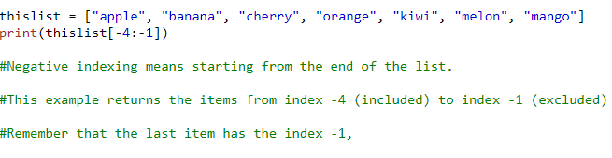

Range of Negative Indexes
Specify negative indexes if you want to start the search from the end of the list:
Example
This example returns the items from "orange" (-4) to, but NOT including "mango" (-1):

Slide 21


Check if Item Exists
To determine if a specified item is present in a list use the in keyword:
Example
Check if "strawberry" is present in the list:

Slide 22


Python - Change List Items
Change Item Value
To change the value of a specific item, refer to the index number:
Example
Check if "apple" is present in the list:

Slide 23


Change a Range of Item Values
To change the value of items within a specific range, define a list with the new values, and refer to the range of index numbers where you want to insert the new values:
Example
Change the values "banana" and "cherry" with the values "blackcurrant" and "watermelon":

Slide 24


If you insert more items than you replace, the new items will be inserted where you specified, and the remaining items will move accordingly:
Example
Change the second value by replacing it with two new values:
Note: The length of the list will change when the number of items inserted does not match the number of items replaced.

Slide 25
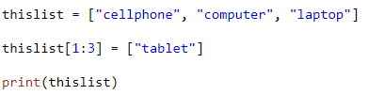

If you insert less items than you replace, the new items will be inserted where you specified, and the remaining items will move accordingly:
Example
Change the second and third value by replacing it with one value:

Slide 26
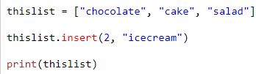

Insert Items
To insert a new list item, without replacing any of the existing values, we can use the insert() method.
The insert() method inserts an item at the specified index:
Example
Insert “icecream" as the third item:
Note: As a result of the example above, the list will now contain 4 items.

Slide 27


Python - Add List Items
Append Items
To add an item to the end of the list, use the append() method:
Example
Using the append() method to append an item:

Slide 28

Insert Items
To insert a list item at a specified index, use the insert() method.
The insert() method inserts an item at the specified index:
Example
Insert an item as the second position:
Note: As a result of the examples above, the lists will now contain 4 items.

Slide 29
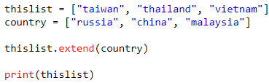
Extend List
To append elements from another list to the current list, use the extend() method.
Example
Add the elements of tropical to thislist:
The elements will be added to the end of the list.

Slide 30
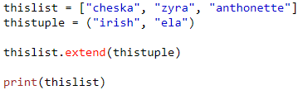

Add Any Iterable
The extend() method does not have to append lists, you can add any iterable object (tuples, sets, dictionaries etc.).
Example
Add elements of a tuple to a list:

Slide 31


Python - Remove List Items
Remove Specified Item
The remove() method removes the specified item.
Example
Remove “blue":

Slide 32


Remove Specified Index
The pop() method removes the specified index.
Example
Remove the second item:

Slide 33


If you do not specify the index, the pop() method removes the last item.
Example
Remove the last item:

Slide 34


The del keyword also removes the specified index:
Example
Remove the last item:

Slide 35


The del keyword can also delete the list completely.
Example
Delete the entire list:

Slide 36


Clear the List
The clear() method empties the list.
The list still remains, but it has no content.
Example
Clear the list content:

Slide 37


Python - Loop Lists
Loop Through a List
You can loop through the list items by using a for loop:
Example
Print all items in the list, one by one:

Slide 38

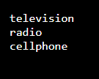
Loop Through the Index Numbers
You can also loop through the list items by referring to their index number.
Use the range() and len() functions to create a suitable iterable.
Example
Print all items by referring to their index number:
The iterable created in the example above is [0, 1, 2].

Slide 39
Using a While Loop
You can loop through the list items by using a while loop.
Use the len() function to determine the length of the list, then start at 0 and loop your way through the list items by referring to their indexes.
Remember to increase the index by 1 after each iteration.

Slide 40
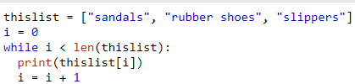
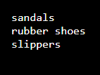
Example
Print all items, using a while loop to go through all the index numbers

Slide 41


Looping Using List Comprehension
List Comprehension offers the shortest syntax for looping through lists:
Example
A short hand for loop that will print all items in a list:

Slide 42
Python - List Comprehension
List Comprehension
List comprehension offers a shorter syntax when you want to create a new list based on the values of an existing list.
Example:
Based on a list of fruits, you want a new list, containing only the fruits with the letter "a" in the name.
Without list comprehension you will have to write a for statement with a conditional test inside:

Slide 43
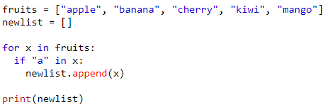

Example

Slide 44
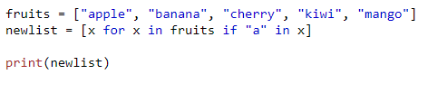

With list comprehension you can do all that with only one line of code:

Slide 45
The Syntax
newlist = [expression for item in iterable if condition == True]
The return value is a new list, leaving the old list unchanged.

Slide 46
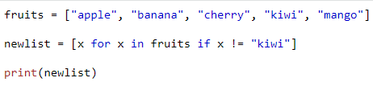

Condition
The condition is like a filter that only accepts the items that valuate to True.
Example
Only accept items that are not "apple":

Slide 47
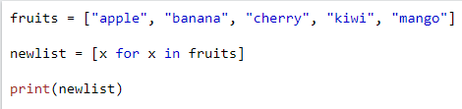

The condition if x != "apple" will return True for all elements other than "apple", making the new list contain all fruits except "apple".
The condition is optional and can be omitted:
Example
With no if statement:

Slide 48




Iterable
The iterable can be any iterable object, like a list, tuple, set etc.
Example
You can use the range() function to create an iterable:
Example
Accept only numbers lower than 5:

Slide 49
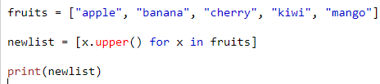
Expression
The expression is the current item in the iteration, but it is also the outcome, which you can manipulate before it ends up like a list item in the new list:
Example
Set the values in the new list to upper case:

Slide 50
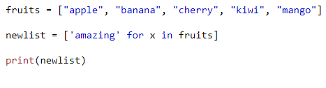

You can set the outcome to whatever you like:
Example
Set all values in the new list to 'hello':

Slide 51
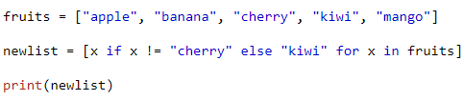

The expression can also contain conditions, not like a filter, but as a way to manipulate the outcome:
Example
Return "orange" instead of "banana":

Slide 52
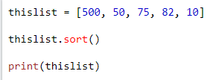
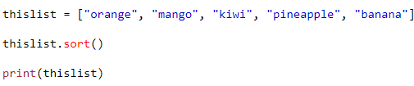

Python - Sort Lists
Sort List Alphanumerically
List objects have a sort() method that will sort the list alphanumerically, ascending, by default:
Example
Sort the list numerically:
Example
Sort the list alphabetically

Slide 53
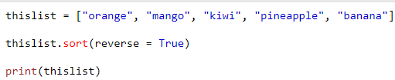
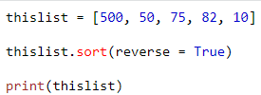


Sort Descending
To sort descending, use the keyword argument reverse = True:
Example
Sort the list descending:
Example
Sort the list descending

Slide 54
Python - Copy Lists
Copy a List
You cannot copy a list simply by typing list2 = list1, because: list2 will only be a reference to list1, and changes made in list1 will automatically also be made in list2.
There are ways to make a copy, one way is to use the built-in List method copy().

Slide 55




example
Another way to make a copy is to use the built-in method list()
Example
Make a copy of a list with the copy() method:
Example
Make a copy of a list with the list() method:

Slide 56
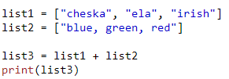

Python - Join Lists
Join Two Lists
There are several ways to join, or concatenate, two or more lists in Python.
One of the easiest ways are by using the + operator.
Example
Join two list:

Slide 57
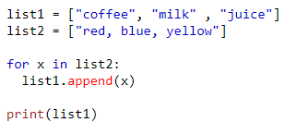

Another way to join two lists is by appending all the items from list2 into list1, one by one:
Example
Append list2 into list1:

Slide 58
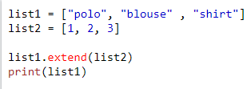

Or you can use the extend() method, which purpose is to add elements from one list to another list:
Example
Use the extend() method to add list2 at the end of list1:

Slide 59
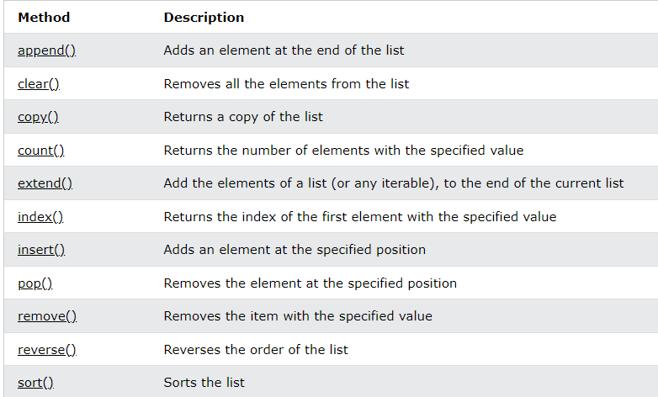
Python - List Methods
List Methods
Python has a set of built-in methods that you can use on lists.’

Slide 60

Python Tuples
Tuple
Tuples are used to store multiple items in a single variable.
Tuple is one of 4 built-in data types in Python used to store collections of data, the other 3 are List, Set, and Dictionary, all with different qualities and usage.
A tuple is a collection which is ordered and unchangeable.
Tuples are written with round brackets.

Slide 61


Example
Create a Tuple:

Slide 62
Tuple Items
Tuple items are ordered, unchangeable, and allow duplicate values.
Tuple items are indexed, the first item has index [0], the second item has index [1] etc.
Ordered
When we say that tuples are ordered, it means that the items have a defined order, and that order will not change.
Unchangeable
Tuples are unchangeable, meaning that we cannot change, add or remove items after the tuple has been created.

Slide 63


Allow Duplicates
Since tuples are indexed, they can have items with the same value:
Example
Tuples allow duplicate values:

Slide 64


Tuple Length
To determine how many items a tuple has, use the len() function:
Example
Print the number of items in the tuple:

Slide 65
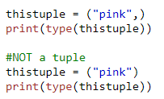

Create Tuple With One Item
To create a tuple with only one item, you have to add a comma after the item, otherwise Python will not recognize it as a tuple.
Example
One item tuple, remember the comma:

Slide 66
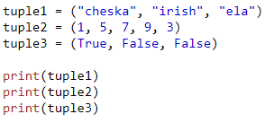

Tuple Items - Data Types
Tuple items can be of any data type:
Example
String, int and boolean data types:

Slide 67


A tuple can contain different data types:
Example
A tuple with strings, integers and boolean values:

Slide 68



type()
From Python's perspective, tuples are defined as objects with the data type 'tuple':
Example
What is the data type of a tuple?

Slide 69


The tuple() Constructor
It is also possible to use the tuple() constructor to make a tuple.
Example
Using the tuple() method to make a tuple:

Slide 70
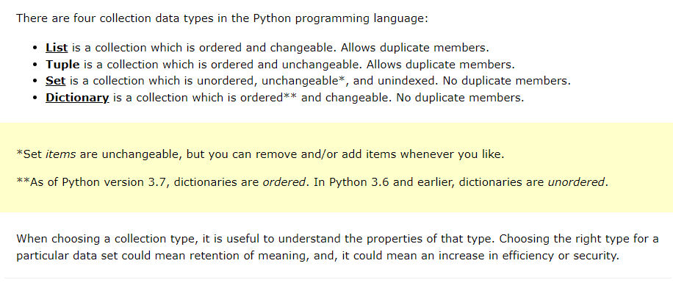
Python Collections (Arrays)

Slide 71


Python - Access Tuple Items
Access Tuple Items
You can access tuple items by referring to the index number, inside square brackets:
Example
Print the second item in the tuple:
Note: The first item has index 0.

Slide 72


Negative Indexing
Negative indexing means start from the end.
-1 refers to the last item, -2 refers to the second last item etc.
Example
Print the last item of the tuple:

Slide 73
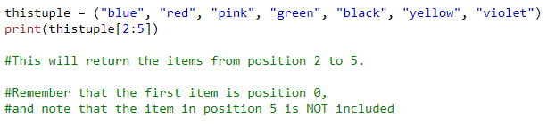

Range of Indexes
You can specify a range of indexes by specifying where to start and where to end the range.
When specifying a range, the return value will be a new tuple with the specified items.
Example
Return the third, fourth, and fifth item:
Note: The search will start at index 2 (included) and end at index 5 (not included).

Slide 74


Remember that the first item has index 0.
By leaving out the start value, the range will start at the first item:
Example
This example returns the items from the beginning to, but NOT included, “sunflower":

Slide 75


By leaving out the end value, the range will go on to the end of the list:
Example
This example returns the items from “pink" and to the end:

Slide 76
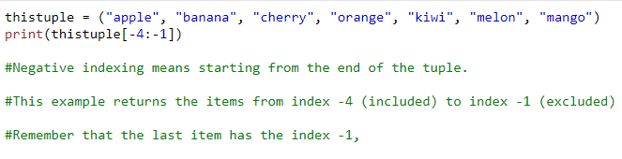

Range of Negative Indexes
Specify negative indexes if you want to start the search from the end of the tuple:
Example
This example returns the items from index -4 (included) to index -1 (excluded)

Slide 77


Check if Item Exists
To determine if a specified item is present in a tuple use the in keyword:
Example
Check if "apple" is present in the tuple:

Slide 78
Python - Update Tuples
Tuples are unchangeable, meaning that you cannot change, add, or remove items once the tuple is created.
But there are some workarounds.
Change Tuple Values
Once a tuple is created, you cannot change its values. Tuples are unchangeable, or immutable as it also is called.

Slide 79
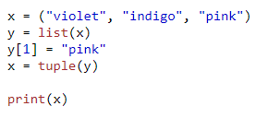

But there is a workaround. You can convert the tuple into a list, change the list, and convert the list back into a tuple
Example
Convert the tuple into a list to be able to change it:

Slide 80
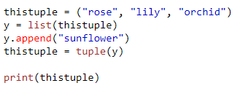

Add Items
Since tuples are immutable, they do not have a build-in append() method, but there are other ways to add items to a tuple.
1. Convert into a list: Just like the workaround for changing a tuple, you can convert it into a list, add your item(s), and convert it back into a tuple.
Example
Convert the tuple into a list, add “sunflower", and convert it back into a tuple:

Slide 81
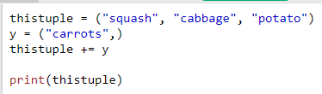

2. Add tuple to a tuple. You are allowed to add tuples to tuples, so if you want to add one item, (or many), create a new tuple with the item(s), and add it to the existing tuple:
Example
Create a new tuple with the value “carrots", and add that tuple:
Note: When creating a tuple with only one item, remember to include a comma after the item, otherwise it will not be identified as a tuple.

Slide 82
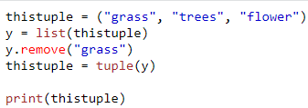

Remove Items
Note: You cannot remove items in a tuple.
Tuples are unchangeable, so you cannot remove items from it, but you can use the same workaround as we used for changing and adding tuple items:
Example
Convert the tuple into a list, remove “grass", and convert it back into a tuple:

Slide 83


Or you can delete the tuple completely:
Example
The del keyword can delete the tuple completely:

Slide 84


Python - Unpack Tuples
Unpacking a Tuple
When we create a tuple, we normally assign values to it. This is called "packing" a tuple:
Example
Packing a tuple:

Slide 85
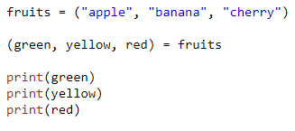

But, in Python, we are also allowed to extract the values back into variables. This is called "unpacking":
Example
Unpacking a tuple:
Note: The number of variables must match the number of values in the tuple, if not, you must use an asterisk to collect the remaining values as a list.

Slide 86
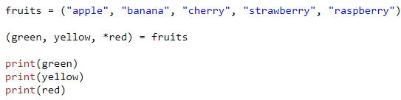
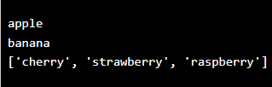
Using Asterisk*
If the number of variables is less than the number of values, you can add an * to the variable name and the values will be assigned to the variable as a list:
Example
Assign the rest of the values as a list called "red":

Slide 87
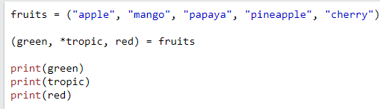

If the asterisk is added to another variable name than the last, Python will assign values to the variable until the number of values left matches the number of variables left.
Example
Add a list of values the "tropic" variable:

Slide 88


Python - Loop Tuples
Loop Through a Tuple
You can loop through the tuple items by using a for loop.
Example
Iterate through the items and print the values:

Slide 89


Loop Through the Index Numbers
You can also loop through the tuple items by referring to their index number.
Use the range() and len() functions to create a suitable iterable.
Example
Print all items by referring to their index number:

Slide 90
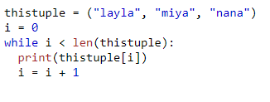

Using a While Loop
You can loop through the list items by using a while loop.
Use the len() function to determine the length of the tuple, then start at 0 and loop your way through the tuple items by referring to their indexes.
Remember to increase the index by 1 after each iteration.
Example
Print all items, using a while loop to go through all the index numbers:

Slide 91
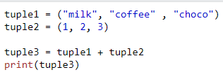

Python - Join Tuples
Join Two Tuples
To join two or more tuples you can use the + operator:
Example
Join two tuples:
Example
Multiply the fruits tuple by 2:

Slide 92


Multiply Tuples
If you want to multiply the content of a tuple a given number of times, you can use the * operator:
Example
Multiply the fruits tuple by 2:

Slide 93
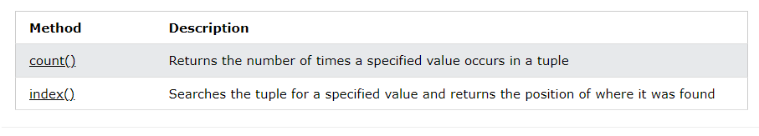
Python - Tuple Methods
Tuple Methods
Python has two built-in methods that you can use on tuples.

Slide 94

Python Sets
Set
Sets are used to store multiple items in a single variable.
Set is one of 4 built-in data types in Python used to store collections of data, the other 3 are List, Tuple, and Dictionary, all with different qualities and usage.
A set is a collection which is unordered, unchangeable*, and unindexed.
* Note: Set items are unchangeable, but you can remove items and add new items.

Slide 95
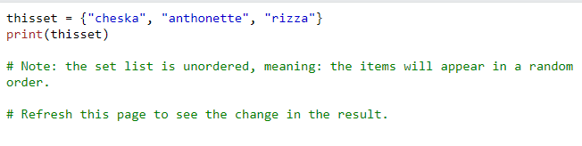

Sets are written with curly brackets.
Example
Create a Set:
Note: Sets are unordered, so you cannot be sure in which order the items will appear.

Slide 96
Set Items
Set items are unordered, unchangeable, and do not allow duplicate values.
Unordered
Unordered means that the items in a set do not have a defined order.
Set items can appear in a different order every time you use them, and cannot be referred to by index or key.
Unchangeable
Set items are unchangeable, meaning that we cannot change the items after the set has been created.
Once a set is created, you cannot change its items, but you can remove items and add new items.

Slide 97
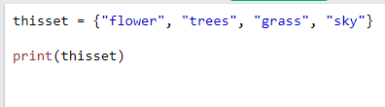

Duplicates Not Allowed
Sets cannot have two items with the same value.
Example
Duplicate values will be ignored:

Slide 98


Get the Length of a Set
To determine how many items a set has, use the len() function.
Example
Get the number of items in a set:

Slide 99
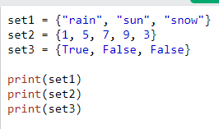



Set Items - Data Types
Set items can be of any data type:
A set can contain different data types:
Example
String, int and boolean data types:
Example
A set with strings, integers and boolean values:

Slide 100



type()
From Python's perspective, sets are defined as objects with the data type 'set'
Example
What is the data type of a set?

Slide 101


The set() Constructor
It is also possible to use the set() constructor to make a set.
Example
Using the set() constructor to make a set:

Slide 102
Python Collections (Arrays)
There are four collection data types in the Python programming language:
List is a collection which is ordered and changeable. Allows duplicate members.
Tuple is a collection which is ordered and unchangeable. Allows duplicate members.
Set is a collection which is unordered, unchangeable*, and unindexed. No duplicate members.
Dictionary is a collection which is ordered** and changeable. No duplicate members.
*Set items are unchangeable, but you can remove items and add new items.
**As of Python version 3.7, dictionaries are ordered. In Python 3.6 and earlier, dictionaries are unordered.
When choosing a collection type, it is useful to understand the properties of that type. Choosing the right type for a particular data set could mean retention of meaning, and, it could mean an increase in efficiency or security.

Slide 103
THANK YOU!

